Slide 1
Control Statements: Part 2; Logical Operators
Chapter 5 of C++ How to Program, 10/e

Slide 2
5.1 Introduction
This chapter continues our presentation of structured-programming theory and principles.
Demonstrates C++’s for, do…while and switch statements.
We explore the essentials of counter-controlled iteration.
We introduce the break and continue program-control statements.
We discuss C++’s logical operators, which enable you to combine simple conditions in control statements.

Slide 3
5.2 Essentials of Counter-Controlled Iteration
Counter-controlled iteration requires
a control variable (or loop counter)
the control variable’s initial value
the control variable’s increment that’s applied during each iteration of the loop
the loop-continuation condition that determines if looping should continue.

Slide 4
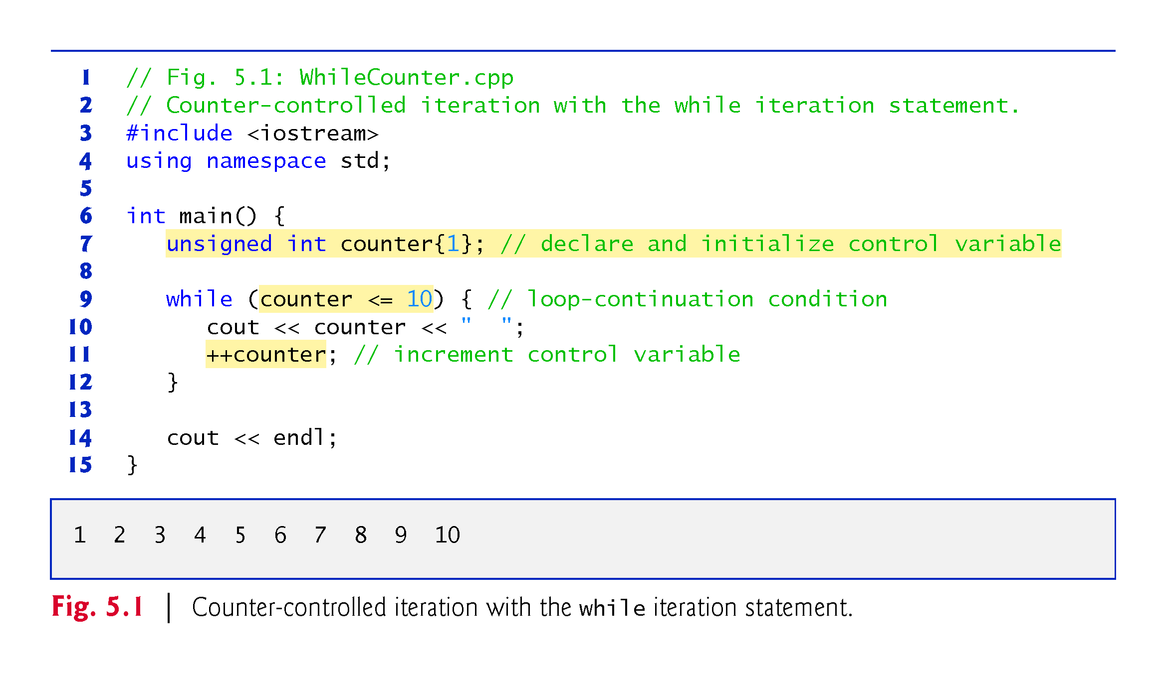

Slide 5
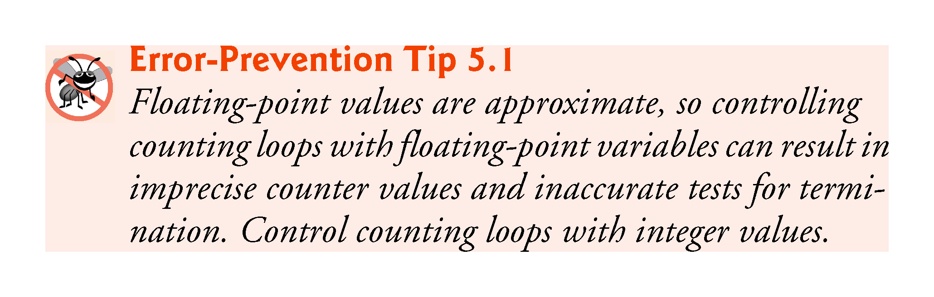

Slide 6
5.3 for Iteration Statement
The for iteration statement (Fig. 5.2) specifies the counter-controlled iteration details in a single line of code.
The initialization occurs once when the loop is encountered.
The condition is tested next and each time the body completes.
The body executes if the condition is true.
The increment occurs after the body executes.
Then, the condition is tested again.

Slide 7
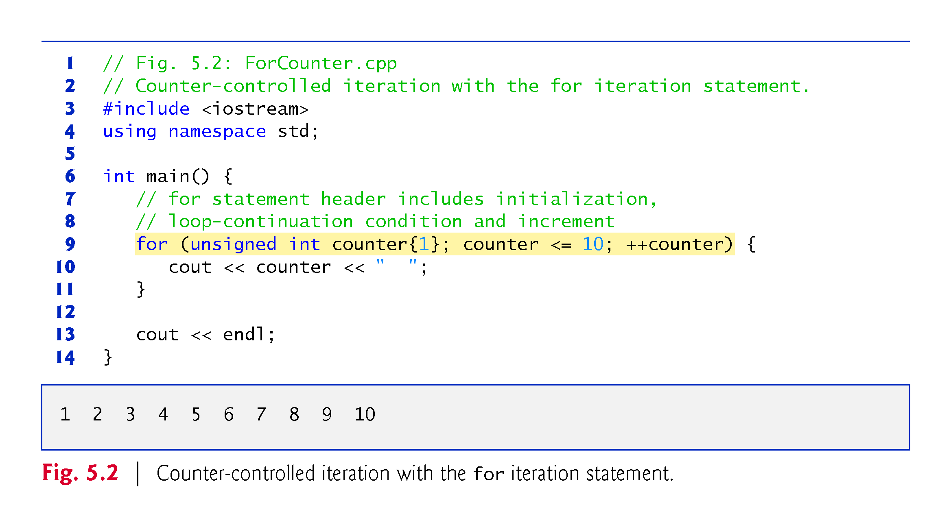

Slide 8
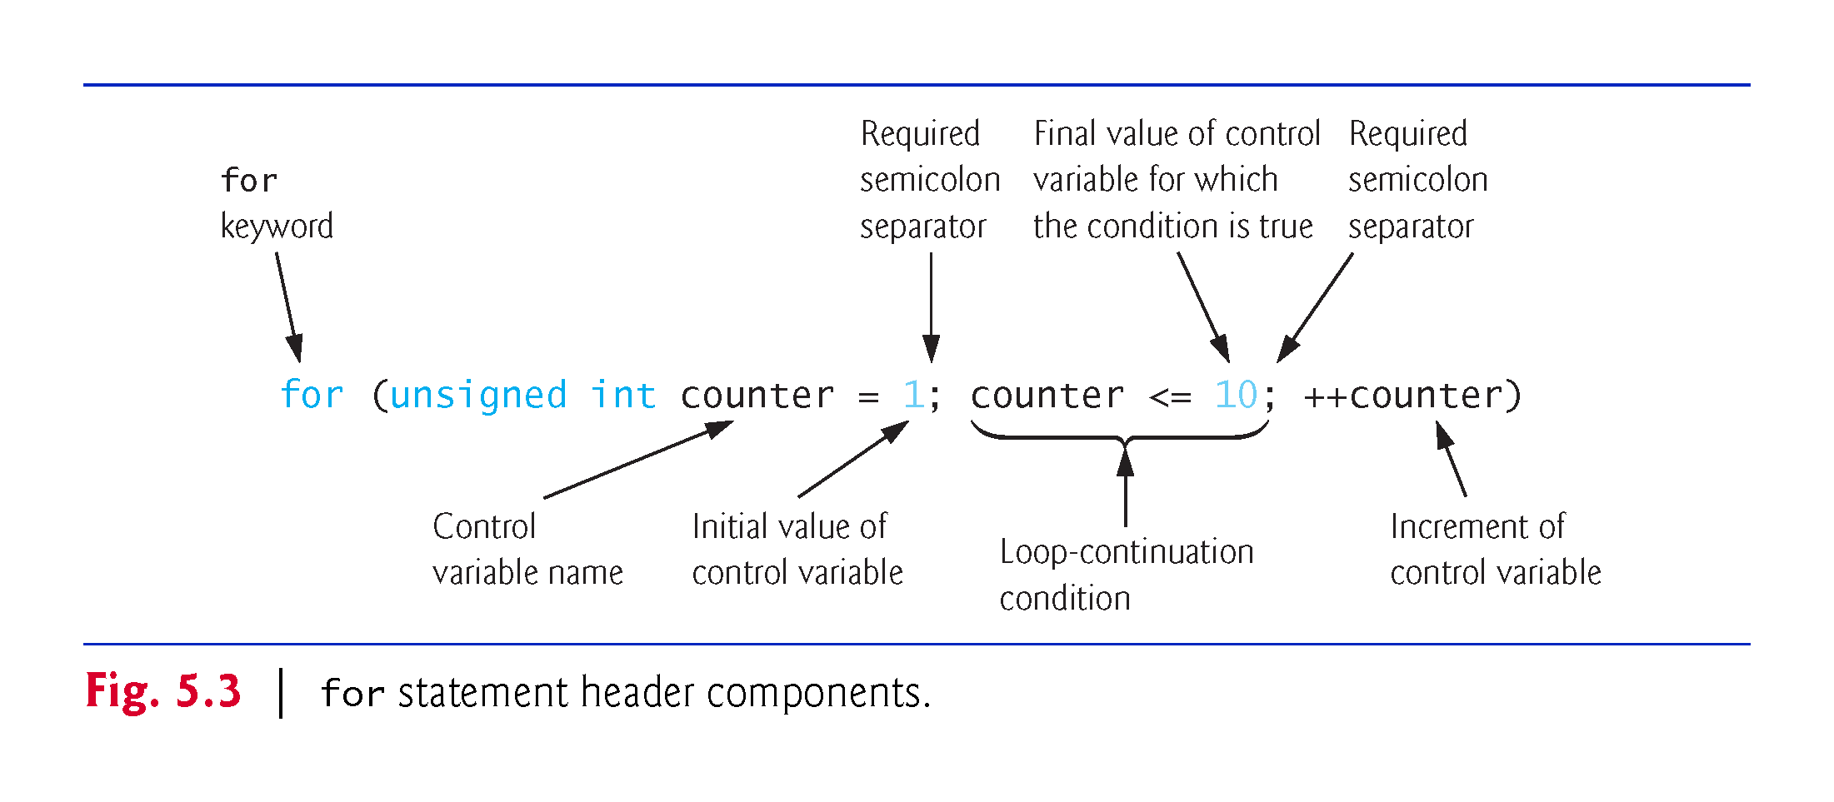
for Statement Header Components

Slide 9
5.3 for Iteration Statement (cont.)
If the initialization expression declares the control variable, the control variable can be used only in the body of the for statement—the control variable will be unknown outside the for statement.
This restricted use of the control variable name is known as the variable’s scope.
The scope of a variable specifies where it can be used in a program.

Slide 10
5.3 for Iteration Statement (cont.)
The three expressions in the for statement header are optional (but the two semicolon separators are required).
If the loopContinuationCondition is omitted, C++ assumes that the condition is true, thus creating an infinite loop.
One might omit the initialization expression if the control variable is initialized earlier in the program.
One might omit the increment expression if the increment is calculated by statements in the body of the for or if no increment is needed.

Slide 11
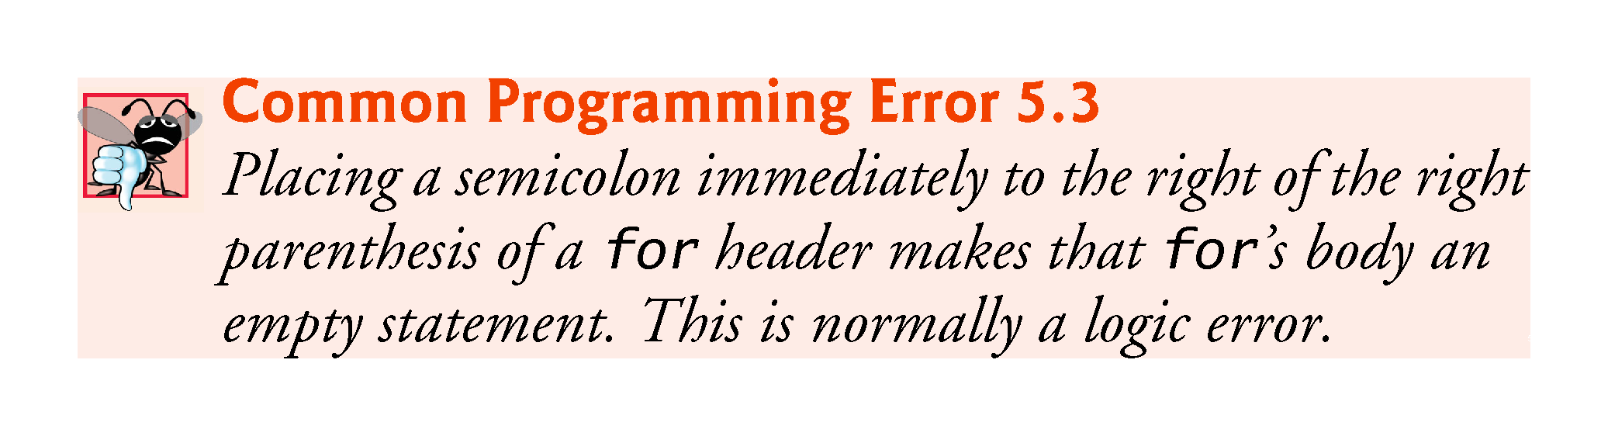

Slide 12
5.3 for Iteration Statement (cont.)
The “increment” of a for statement can be negative, in which case it’s really a decrement and the loop actually counts downward.
If the loop-continuation condition is initially false, the body of the for statement is not performed.

Slide 13
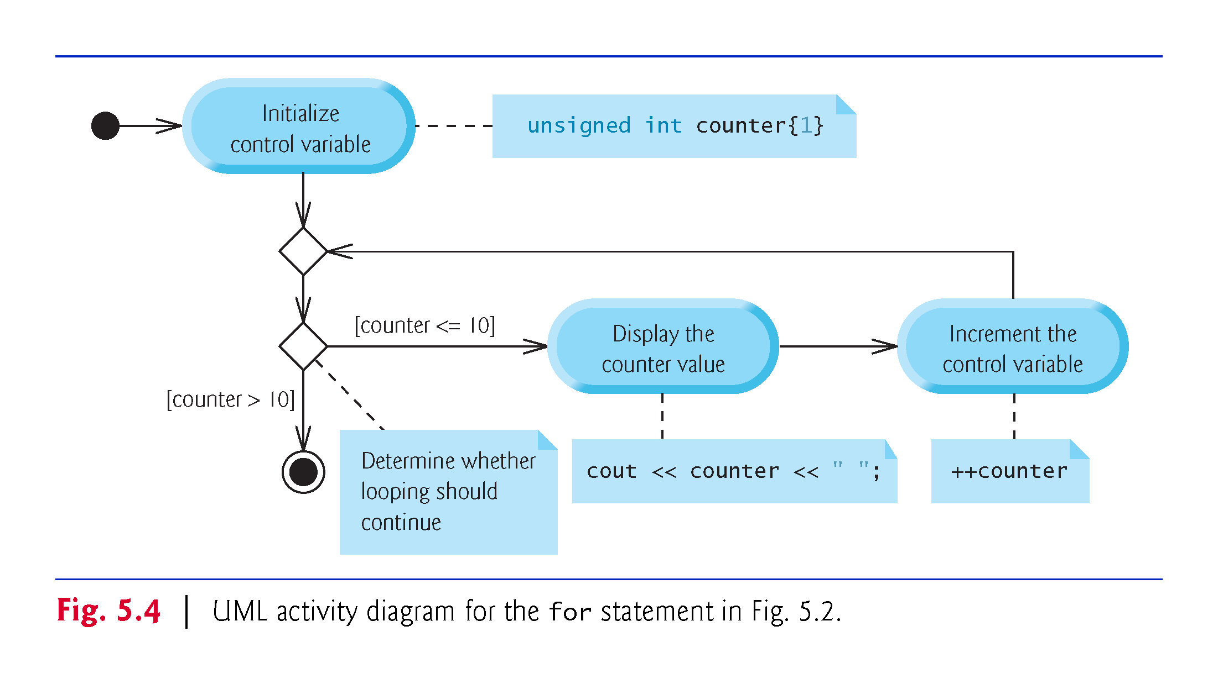

Slide 14
5.4 Examples Using the for Statement
Count from 1 to 100 in increments of 1.
for (unsigned int i = 1; i <= 100; ++i)
Count from 100 down to 1 in decrements of 1.
for (unsigned int i = 100; i >= 1; --i)
Count from 7 to 77 in steps of 7.
for (unsigned int i = 7; i <= 77; i += 7)
Count from 20 down to 2 in steps of -2.
for (unsigned int i = 20; i >= 2; i -= 2)
Iterate over the sequence 2, 5, 8, 11, 14 , 17 , 20.
for (unsigned int i = 2; i <= 20; i += 3)
Iterate over the sequence 99, 88, 77, 66 , 55 , 44 , 33 , 22 , 11, 0. We use int rather than unsigned int here because the condition does not become false until i’s value is -11, so the control variable must be able to represent both positive and negative values.
for (int i = 99; i >= 0; i -= 11)

Slide 15
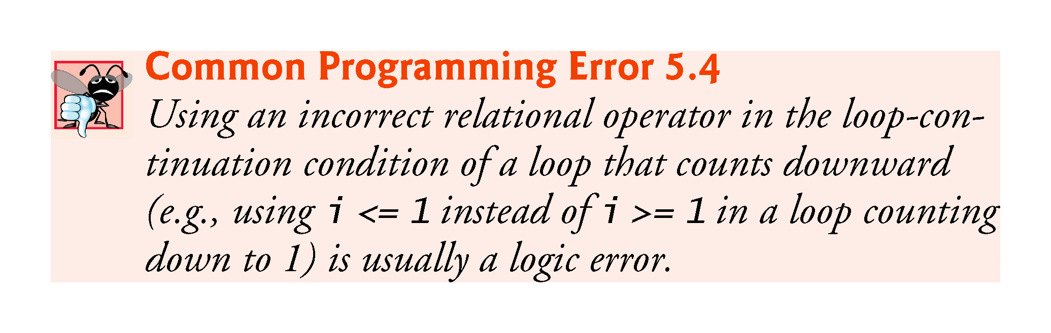

Slide 16
5.5 Application: Summing Integers
Write a program that takes a number n from the user and finds the sum of all the numbers from 1 to n and prints it.
Modify the program so that it also prints the product of the numbers. How high can n be?
How can we modify our variables to be able to use higher n?

Slide 17
5.6 Application: Compound-Interest Calculations
Consider the following problem statement:
A person invests $1000.00 in a savings account yielding 5% interest. Assuming that all interest is left on deposit in the account, calculate and print the amount of money in the account at the end of each year for 10 years. Use the following formula for determining these amounts: a = p (1 + r) ^{n} where p is the original amount invested (i.e., the principal), r is the annual interest rate, n is the number of years and a is the amount on deposit at the end of the nth year.
This problem involves a loop that performs the indicated calculation for each of the 10 years the money remains on deposit (Fig. 5.6).

Slide 18
5.6 Application: Compound-Interest Calculations (cont.)
C++ does not include an exponentiation operator, so we use the standard library function pow.
pow(x, y) calculates the value of x raised to the y^{th} power.
Takes two arguments of type double and returns a double value.
This program will not compile without including header file <cmath>.
Includes information that tells the compiler to convert the value of year to a temporary double representation before calling the function.
Contained in pow’s function prototype.

Slide 19
5.6 Application: Compound-Interest Calculations (cont.)
Using Stream Manipulators to Format Numeric Output
Parameterized stream manipulators setprecision and setw and the nonparameterized stream manipulator fixed.
The stream manipulator setw(4) specifies that the next value output should appear in a field width of 4—i.e., cout prints the value with at least 4 character positions.
If less than 4 character positions wide, the value is right justified in the field by default.
If more than 4 character positions wide, the field width is extended rightward to accommodate the entire value.
To indicate that values should be output left justified, simply output nonparameterized stream manipulator left .
Right justification can be restored by outputting nonparameterized stream manipulator right.

Slide 20
5.6 Application: Compound-Interest Calculations (cont.)
Stream manipulator fixed indicates that floating-point values should be output as fixed-point values with decimal points.
Stream manipulator setprecision specifies the number of digits to the right of the decimal point.
Stream manipulators fixed and setprecision remain in effect until they’re changed—such settings are called sticky settings.
The field width specified with setw applies only to the next value output.

Slide 21
5.6 Application: Compound-Interest Calculations (cont.)
Variables of type float represent single-precision floating-point numbers and have approximately seven significant digits on most of today’s systems.
Variables of type double represent double-precision floating-point numbers.
These require twice as much memory as float variables and provide approximately 15 significant digits on most of today’s systems—approximately double the precision of float variables.

Slide 22
5.6 Application: Compound-Interest Calculations (cont.)
Most programmers represent floating-point numbers with type double.
C++ treats all floating-point numbers you type in a program’s source code (such as 7.33 and 0.0975) as double values by default.
Such values in the source code are known as floating-point literals.

Slide 23
5.6 Application: Compound-Interest Calculations (cont.)
In conventional arithmetic, floating-point numbers often arise as a result of division—when we divide 10 by 3, the result is 3.3333333…, with the sequence of 3s repeating infinitely.
The computer allocates only a fixed amount of space to hold such a value, so clearly the stored floating-point value can be only an approximation.
double suffers from what we call representational error.

Slide 24
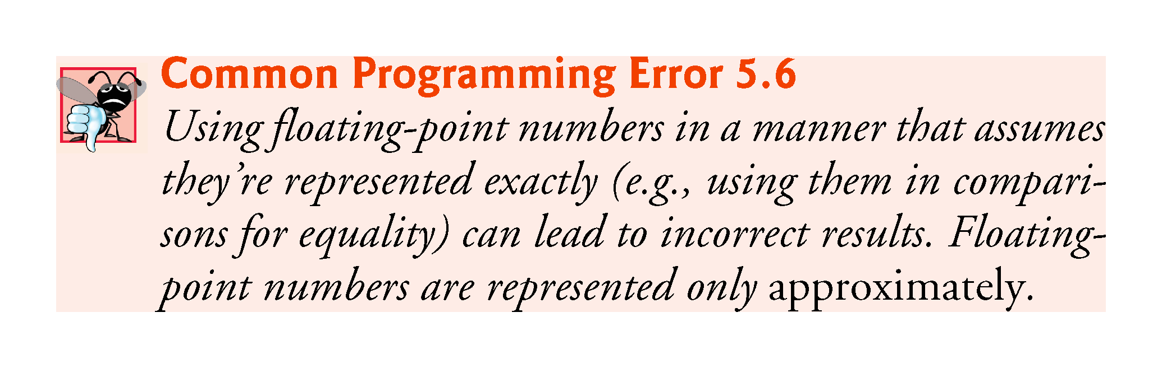

Slide 25
5.6 Application: Compound-Interest Calculations (cont.)
Simple explanation of what can go wrong when using double (or float) to represent dollar amounts (assuming that dollar amounts are displayed with two digits to the right of the decimal point):
Two calculated double dollar amounts stored in the machine could be 14.234 (which would normally be rounded to 14.23 for display purposes) and 18.673 (which would normally be rounded to 18.67 for display purposes).
When these amounts are added, they produce the internal sum 32.907, which would normally be rounded to 32.91 for display purposes. Thus, your output could appear as
14.23 + 18.67 32.91
A person adding the individual numbers as displayed would expect the sum to be 32.90.

Slide 26
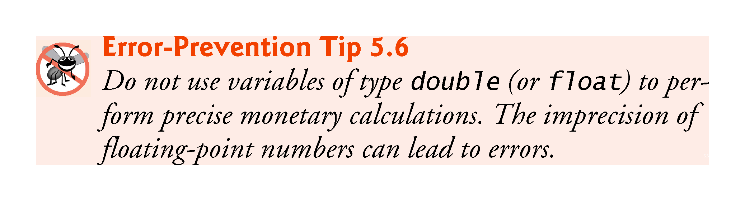

Slide 27
5.8 do…while Iteration Statement
Similar to the while statement.
The do…while statement tests the loop-continuation condition after the loop body executes; therefore, the loop body always executes at least once.
Figure 5.9 uses a do…while statement to print the numbers 1–10.

Slide 28
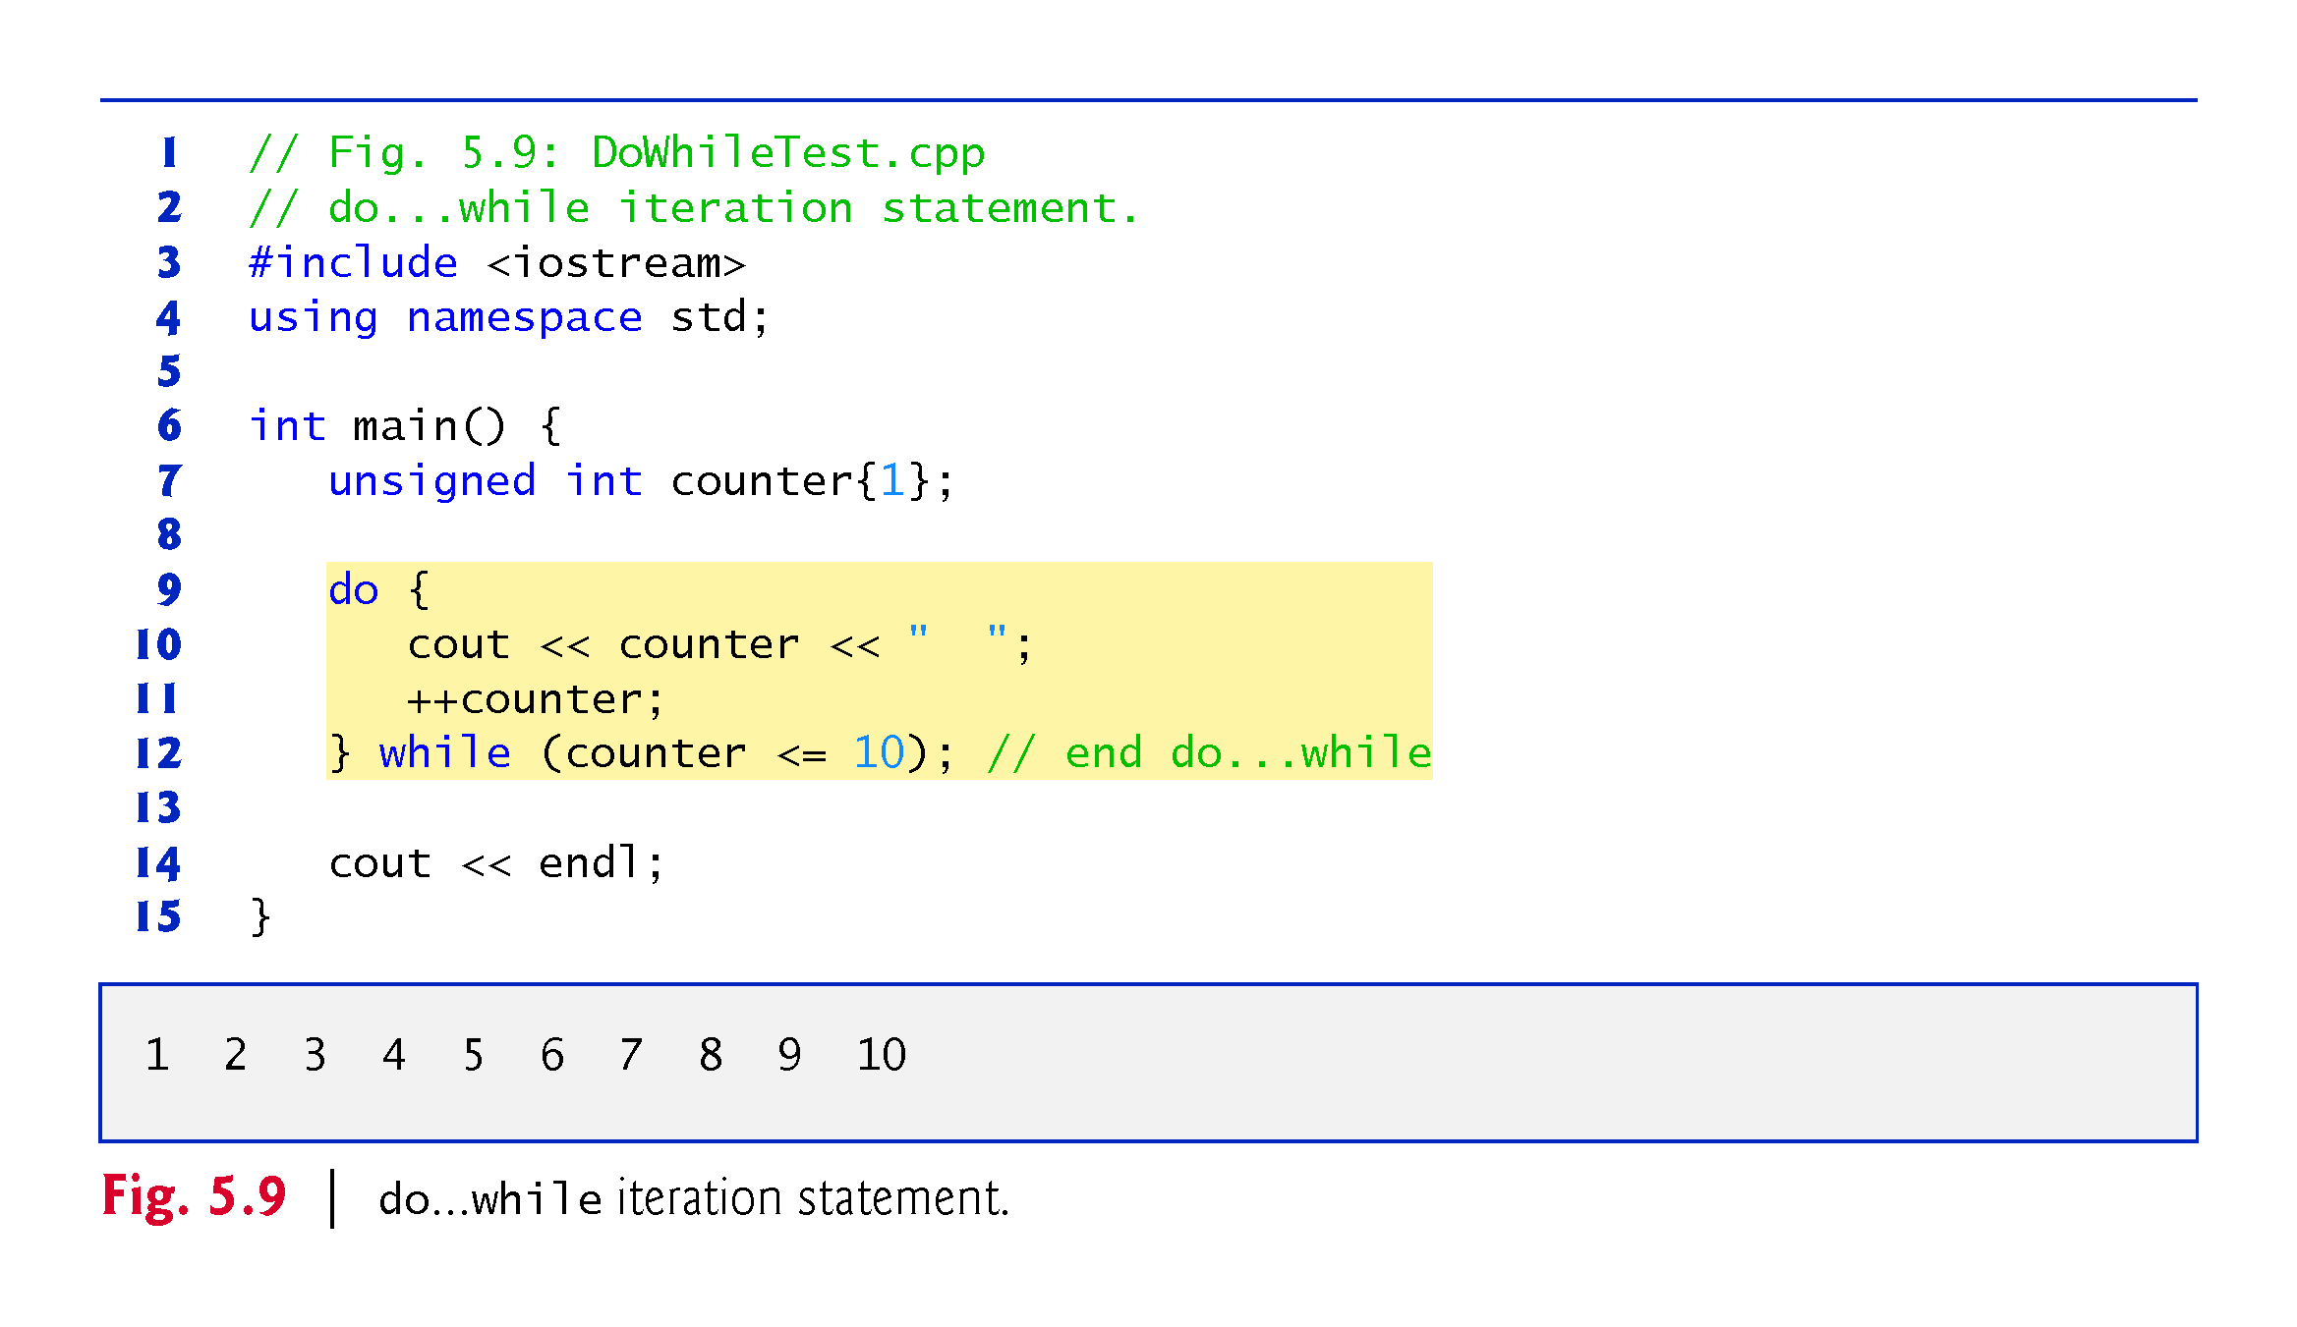

Slide 29
5.8 do…while Iteration Statement (cont.)
do…while Statement UML Activity Diagram
Figure 5.10 contains the do…while statement’s UML activity diagram, which makes it clear that the loop-continuation condition is not evaluated until after the loop performs its body at least once.

Slide 30
